Slide 1
BLG 433E COMPUTER COMMUNICATIONS: WIRESHARK TUTORIAL
Instructor: Prof. Sema F. OKTUĞ
Teaching Assistant: Yusuf ÖZÇEVİK
FALL 2018-2019

Slide 2
OUTLINE
Introduction
What is Wireshark?
Building and Installing Wireshark
Traffic Monitoring
Capturing Packets
Analyzing Packets
Filtering Packets etc.

Slide 3
INTRODUCTION What is Wireshark?
Network packet analyzer [1]
Capture network packets
Display that packet data as detailed as possible
Some examples:
Network administrators use it to troubleshoot network problems
Network security engineers use it to examine security problems
Developers use it to debug protocol implementations
People use it to learn network protocol internals
[1] Wireshark User Guide

Slide 4
INTRODUCTION What is Wireshark?
Wireshark:
is not an intrusion detection system
does not manipulate things on the networks,
only “measure” things from the network

Slide 5
INTRODUCTION Building and Installation
Microsoft Windows
UNIX/Linux
https://www.wireshark.org/ download.html.
$ tar xaf wireshark-2.4.5.tar.xz
$ cd wireshark-2.4.5
$ ./configure
$ make
$ make install

Slide 6
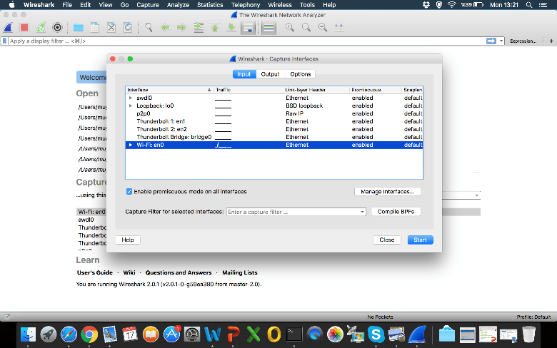
TRAFFIC MONITORING Capturing Packets

Slide 7
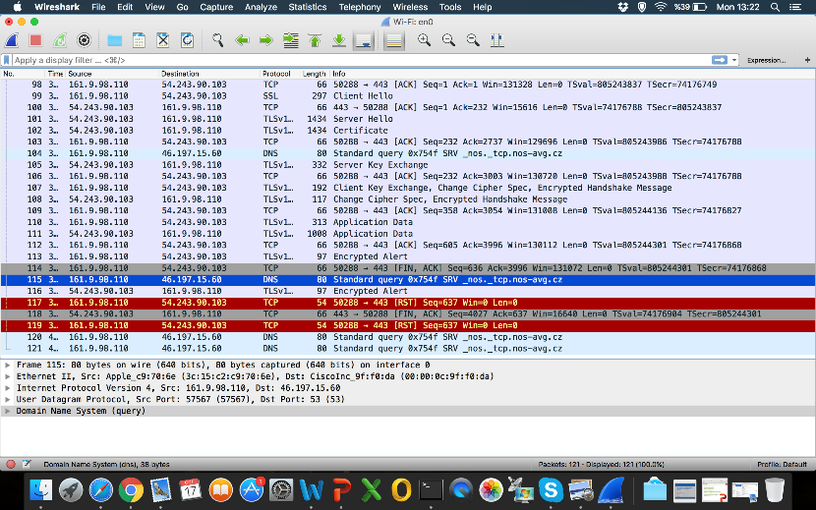
TRAFFIC MONITORING Capturing Packets
Notes:
Menu
Main toolbar
Filter toolbar
Packet list pane
Packet details pane
Status bar

Slide 8
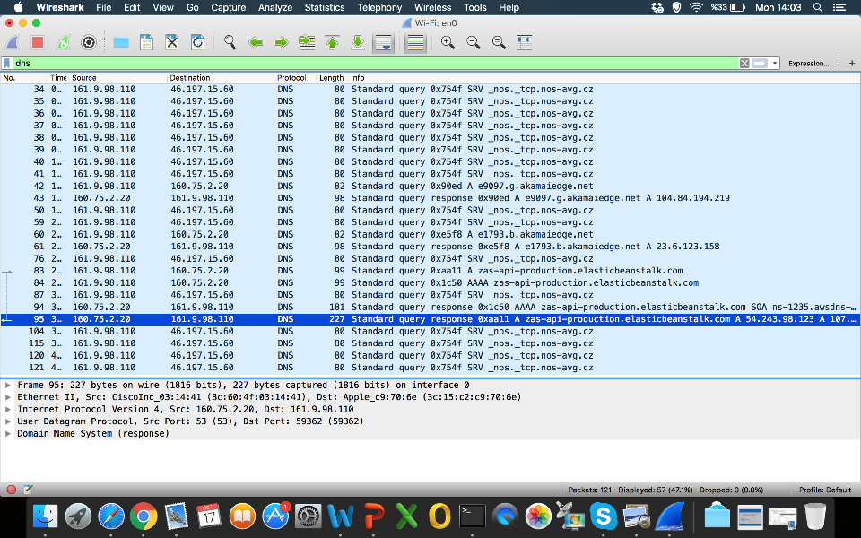
TRAFFIC MONITORING Filtering Packets
Notes:
Dns filtering

Slide 9
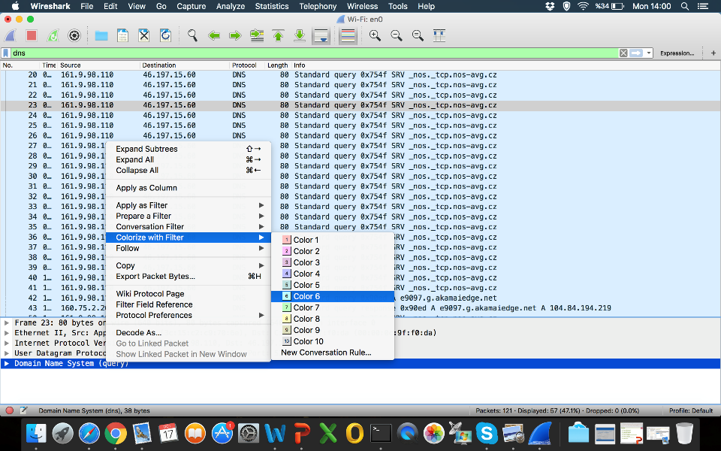
TRAFFIC MONITORING Analyzing Packets
Notes:
Pop up menu of packet list pane –> Coloring

Slide 10
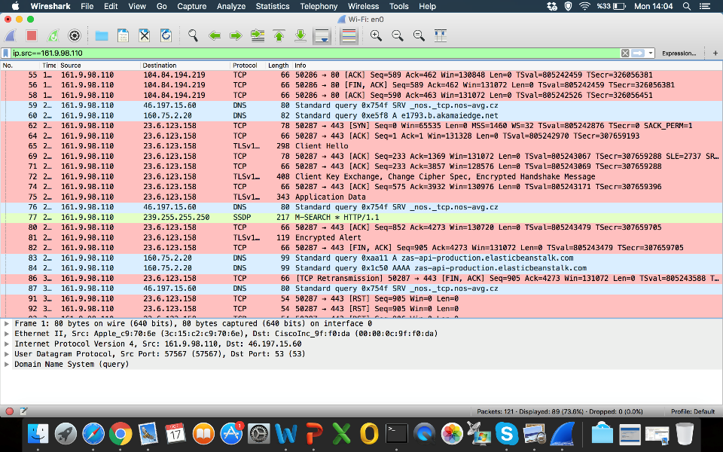
TRAFFIC MONITORING Filtering Packets
Notes:
Ip.src== filtering

Slide 11
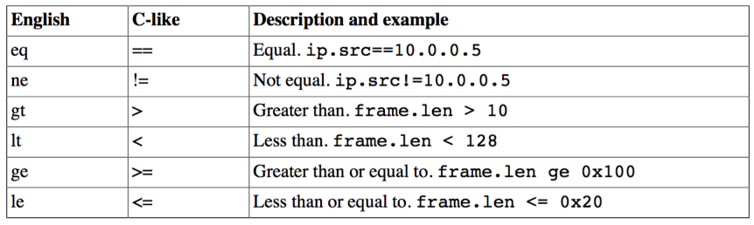
TRAFFIC MONITORING Filtering Packets
* Taken from Wireshark User Guide

Slide 12
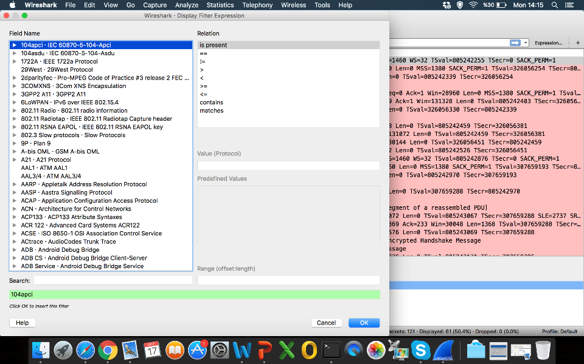
TRAFFIC MONITORING Filtering Packets
Notes:
Filter expressions

Slide 13
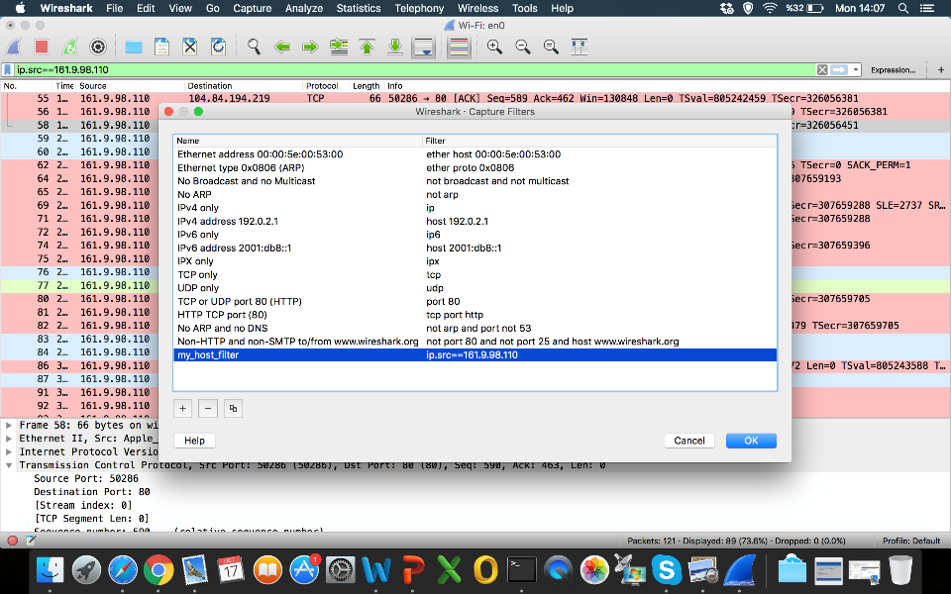
TRAFFIC MONITORING Filtering Packets
Notes:
Saving Filter

Slide 14
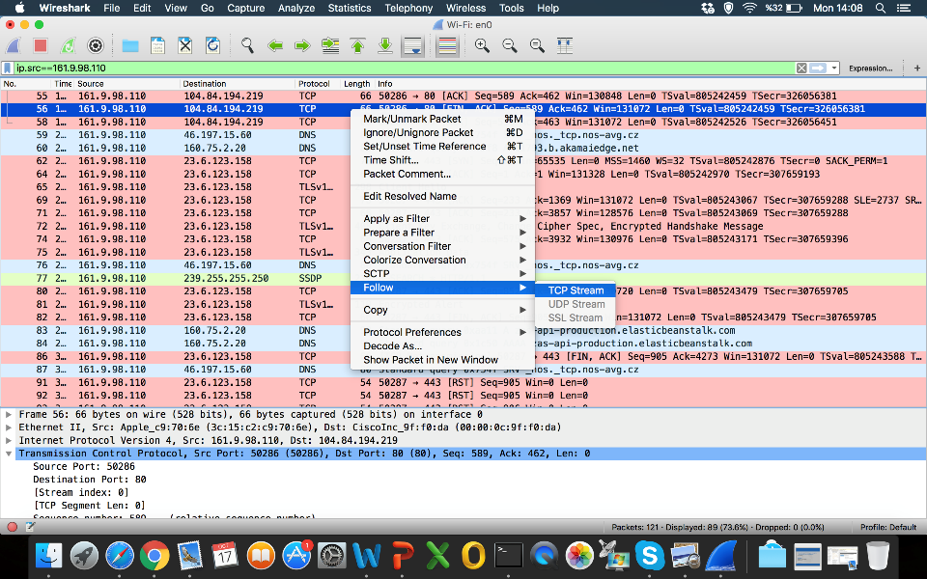
TRAFFIC MONITORING
Notes:
Follow TCP stream

Slide 15
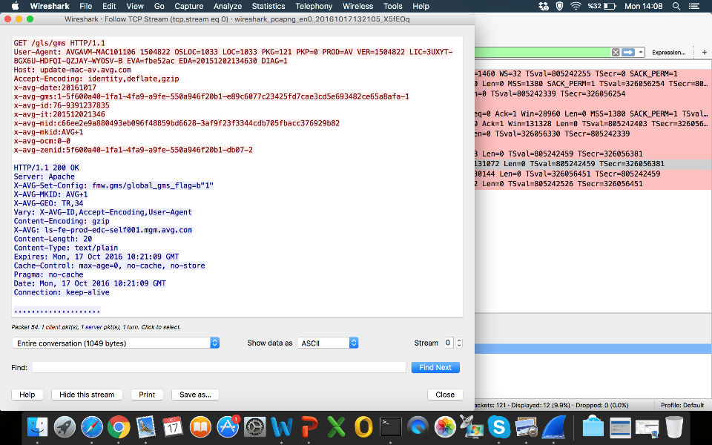
TRAFFIC MONITORING
Notes:
Follow HTTP stream

Slide 16
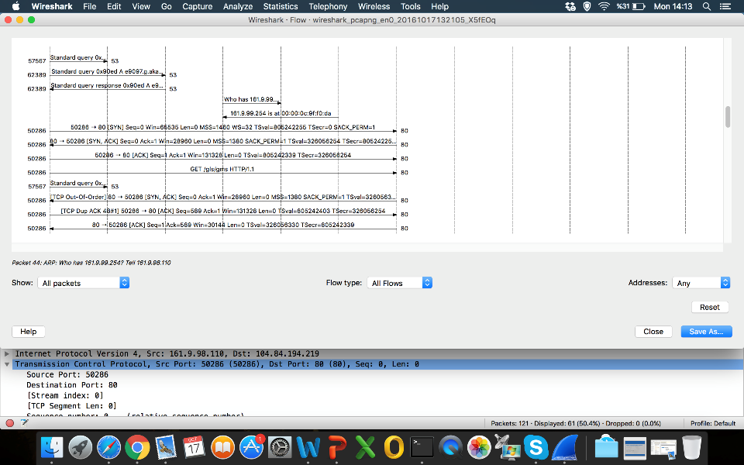
TRAFFIC MONITORING
Notes:
Flow graph

Slide 17
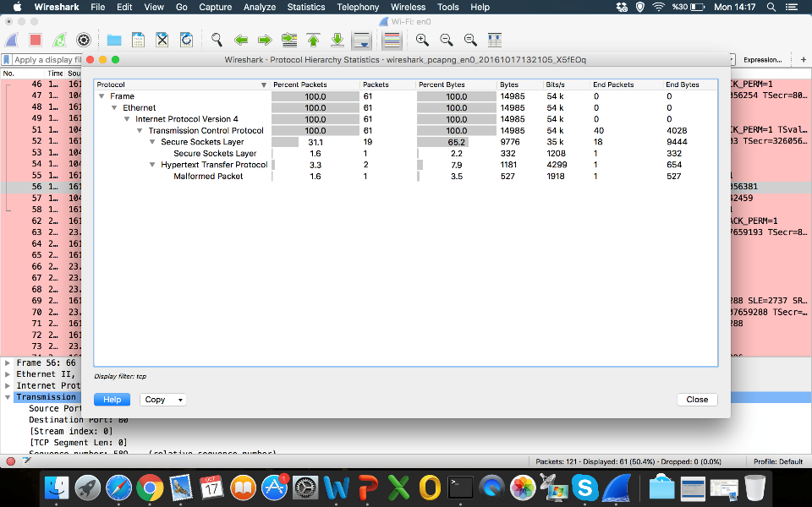
TRAFFIC MONITORING
Notes:
Protocol hierarchy statistics

Slide 18
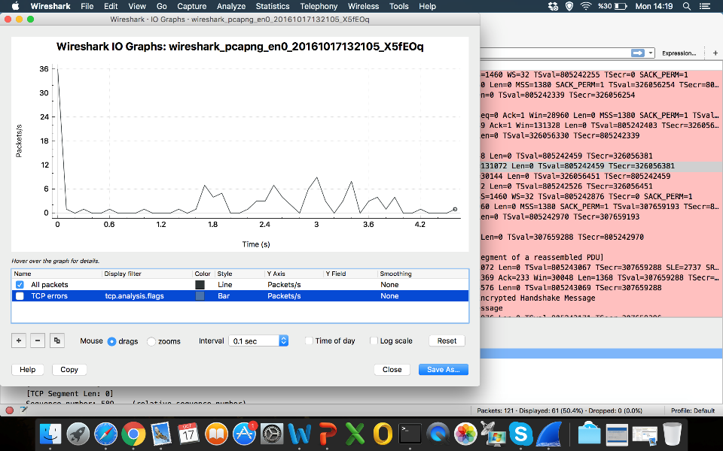
TRAFFIC MONITORING
Notes:
I/O Graph

Slide 19
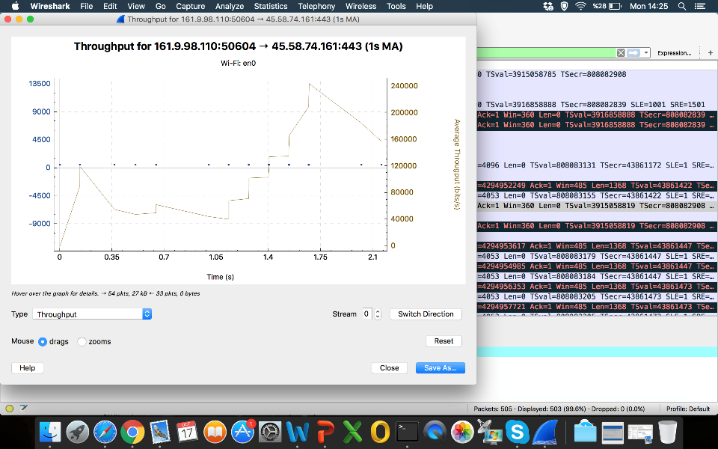
TRAFFIC MONITORING
Notes:
Statistics->TCPStream->
RTT
Throughput
etc

